Slide 1
Earthquake Proof Buildings
Objective. – To design a earthquake proof building for San Francisco or Tokyo that considers the key ideas of design, construction and geology

Slide 2
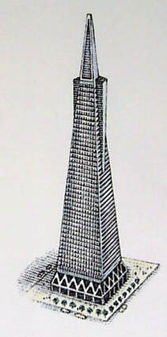
How is this building ‘earthquake proof’?
Counter-weighting: Large weights are placed on top of the building to help counter the effects of sway when the ground shakes.
Steel K-bracing: Steel bracing has been used at the base of the building to help hold the walls together. When the ground shakes the walls are more likely to stay held together by the steel braces, which are light-weight and fairly flexible. The steel bends with the seismic waves and so is less likely to break apart.
Geology: The building is built on a hard rock, through which seismic waves travel slowly, reducing the shaking to a minimum.

Slide 3
Design, Construction and Geology
Design: http://uk.youtube.com/watch?v=LwSikXWcGC4
Construction: http://uk.youtube.com/watch?v=dddbsODis2M
Geology: http://www.youtube.com/watch?v=_pWy1e6Q8k4

Slide 4
Today’s Task
Design a earthquake proof building
Your building should take into consideration design, construction and geology
Pick between 5-10 characteristics from the next page
Draw your building at the centre of your page.
Label your building to describe the characteristics you’ve chosen and explain why you’ve included them.

Slide 5
Pick between 5-10 characteristics from the list below
Triangular shape | Square shape | Circular shape | X bracing
Short building | Tall building | Base isolators | K bracing
Counter-weights | Shock absorbers | Fixed base | No bracing
Steel | Concrete | Paper | Wood
Glass | Bricks | Plastic | Tiles
Sand | Soft mud | Hard bedrock | Reclaimed land
Steep Slope | Flat land | Near a fault line | Away from a fault

Slide 6
Peer Assessment
One positive comment – what did they do really well?
One improvement – what could they do better?
Write your comments on the back of the page.

