Slide 1
IB DP Revision Session The Final Countdown!

Slide 2
Everthing is Geography ..
There are 20 items in the room set out in front of you.
Pick any one (the more unusual the better).
Take it back to your table and place it in the centre (if it fits) of your A3 paper and you have 5 minutes to tell me why this item is so important to your Geography IB DP Standard Level course.
Then complete the rest of the sheet using bullet points to link the item to key areas of the SL course

Slide 3
Part 1 – Core Patterns & Change (Paper 1)

Slide 4
Command Term – Pick n Mix

Slide 5
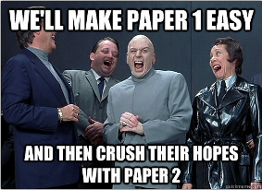
Possible Questions – Paper 1 – Activity

Slide 6
Paper 2 – Sport, Leisure & Tourism

Slide 7
Either Question 9 or Question 10 … ALWAYS
Note, sometimes they are on different pages so you’ll have to turn over to check.
#firstworldproblems

Slide 8
Choice! This one …. Or This one…

