Slide 1
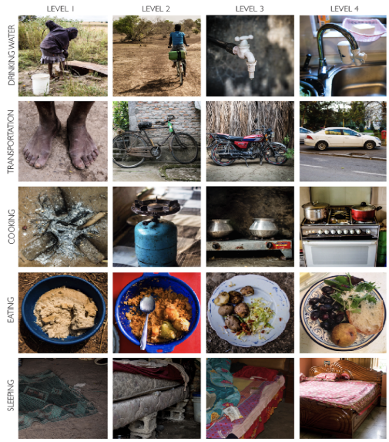
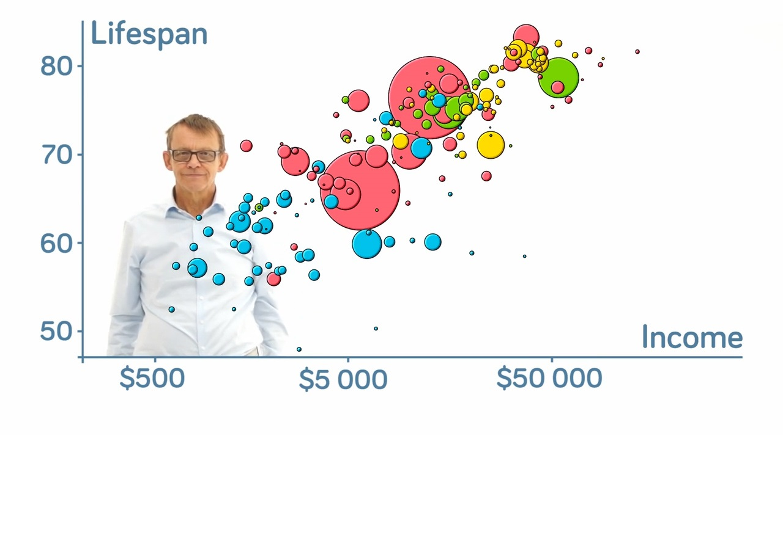
Grade 6 Geography Factfulness
Your name here:
Link to live Gapminder Bubble Chart – Click here
Life in the four levels …. In 50 words.

Slide 2
Level 1
Example Country 1:
Example Country 2:
Example Country 3:
Life in this country in 50 words:
Paste a photo that shows what life is like in this level.

Slide 3
Level 2
Example Country 1:
Example Country 2:
Example Country 3:
Life in this country in 50 words:
Paste a photo that shows what life is like in this level.

Slide 4
Level 3
Example Country 1:
Example Country 2:
Example Country 3:
Life in this country in 50 words:
Paste a photo that shows what life is like in this level.

Slide 5
Level 4
Example Country 1:
Example Country 2:
Example Country 3:
Life in this country in 50 words:
Paste a photo that shows what life is like in this level.

