Slide 1
The Ice Man
Further Evidence – How did the body stay so well preserved and why didn’t it move far from place of death?

Slide 2
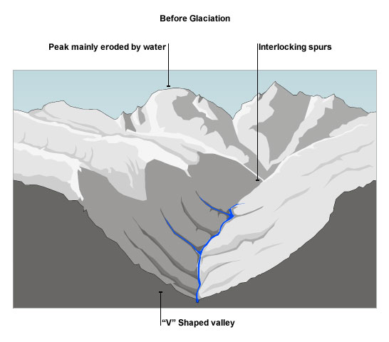
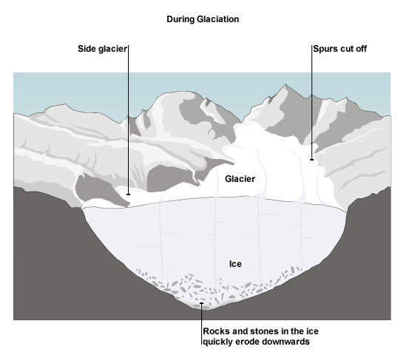
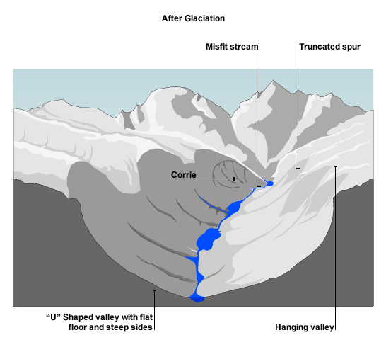
How do glaciers change the landscape?

Slide 3
