Slide 1
Fashion Slavery or Economic Saviour? Should children be allowed to work in sweatshops?
By:

Slide 2
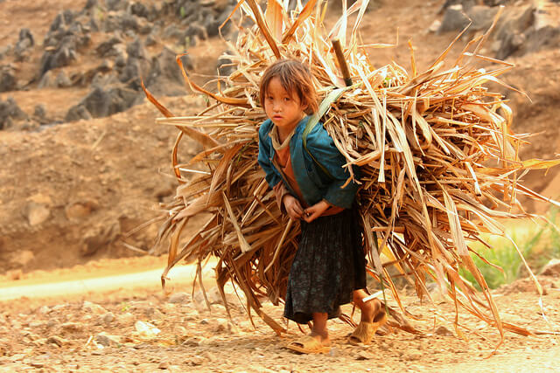
Negatives of child labour
Child labour can sometimes be dangerous for children…

Slide 3
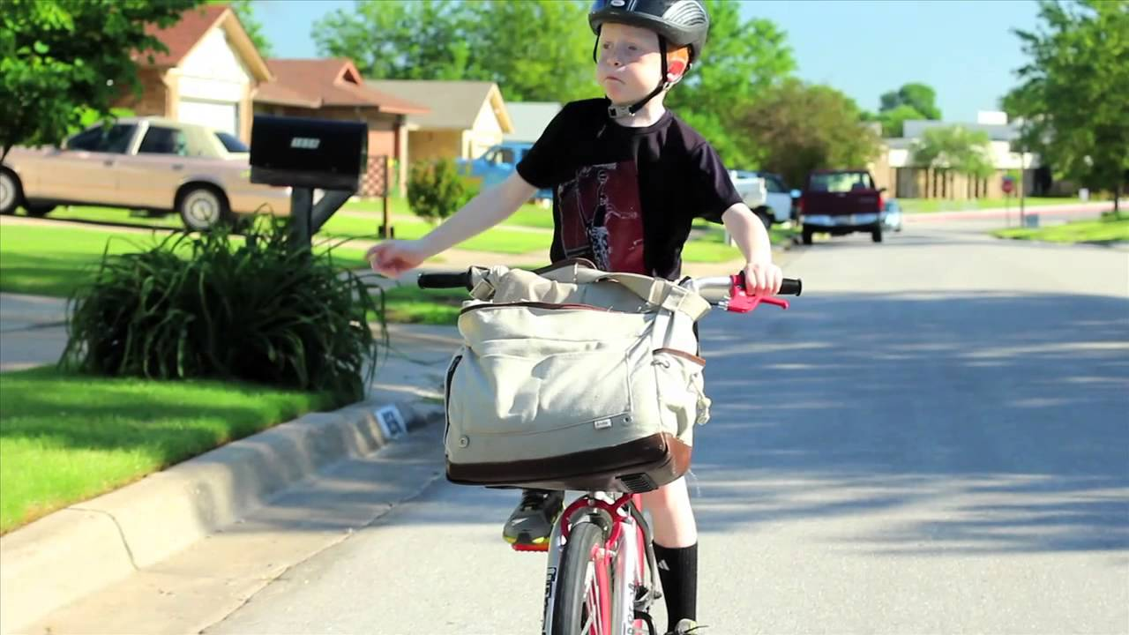
Positives of child labour
In poor countries some children work to earn more money and make their families be able to afford a house and food .

Slide 4
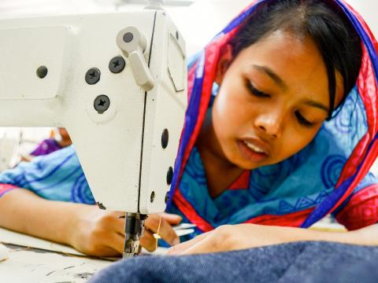
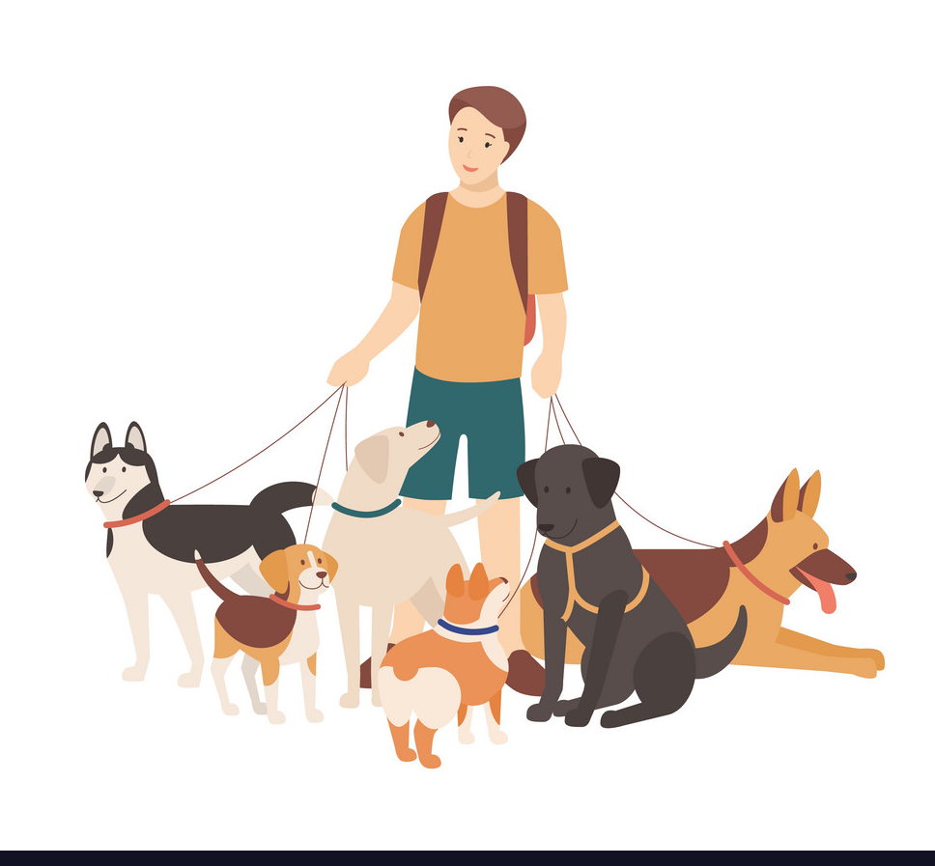
My opinion – in 200 words
Overall, I think that…

