Slide 1
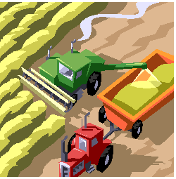
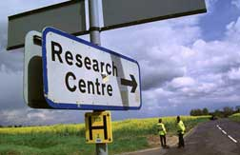
Economic Development
Lastminutegcsegeographyrevison@kingdown
Slide 1

Slide 2
Preparation before starting this Revision unit you need to have:-
Sorted you theory notes and produced a contents page
Have your case studies completed
Introduction
This unit is to give you 40 minutes of Geography Revision on the ECONOMIC DEVELOPMENs topic. Work through the tasks and stick to the timings. You could work through this unit more than once
Resources
You will find these resources useful
Contents page from your files, the supporting PowerPoint presentation (this can be downloaded to your MP3 player or phone) the topic glossary
Lastminutegcsegeographyrevison@kingdown
Slide 2

Slide 3
You may begin…..
Record down your start time
Slide 3

Slide 4
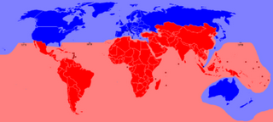
40 35 30 25 20 15 10 5 0
What is Development ?
Development means improving the economic and social conditions in a country and the quality of life of the people living there. It is more than wealth as it includes such things as happiness and the state of the environment’.
1. What is Quality of Life?
2. What is standard of Living?
How can we measure well being and quality of life?
3. Name ONE economic, ONE social and ONE environmental indicator we can use to show how developed a country is.
4. What is the Human Development Index (HDI)
5. Name the 3 indicators used to calculate
Slide 4

Slide 5
40 35 30 25 20 15 10 5 0
5. Name the 5 stages of Rostows model?
6. Which stage do these statements refer to?
1. A subsistence economy based upon farming 2. A rapid expansion of service industries 3.A country usually needs external help to move to this stage 4.Insufficient technology and capital to process raw materials 5. Most products are exported 6. Slow improvement in the standard of living (GNP) 7. Growth in the Quaternary sector
8. The manufacturing industry grows rapidly 9. Increasing investment 10. Rapid Urbanisation 11. Economic development confined to just 1 or 2 core regions 12. Rapid improvement in Standard of living
13. Higher levels of technology 14. Deindustrialisation
Slide 5

Slide 6
40 35 30 25 20 15 10 5 0
How development can be affected by aid.
7 Complete the table to show how the development Gap can be reduced
METHOD | DESCRIPTION | ADVANTAGES | DISADVANTAGES
MULTINATIONAL INVESTMENT
DEVELOPMENT OF TOURISM
DEVELOPMENT PROJECTS
INTERMEDIATE TECHNOLOGY
FAIR TRADE
REDUCING DEBT
Slide 6

Slide 7
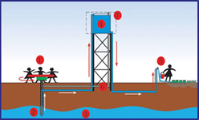
40 35 30 25 20 15 10 5 0
CASE STUDY Play Pump Scheme
Name Location
Details
EFFECT | Positive | Negative
Effect on Environment
Effect on Economy
Effect on People
Slide 7

Slide 8
40 35 30 25 20 15 10 5 0
CASE STUDY Play Pump Scheme
How is the scheme Sustainable?
FUTURITY Long Term
COMMUNITY INVOLVEMENT Bottom Up
ENVIRONMENTAL CONSERVATION Eco Friendly
SOCIAL JUSTICE Reduces poverty
Slide 8

Slide 9
40 35 30 25 20 15 10 5 0
Employment structures ? How and why patterns of employment structure vary in contrasting locations
processing and manufacturing
Hi Tech industries
QUATERNARY INDUSTRY
TERTIARY INDUSTRY
PRIMARY INDUSTRY
SECONDARY INDUSTRY
service industries
Extracting resources from the ground, land and sea
8. Match the labels to the picture
Slide 9

Slide 10
40 35 30 25 20 15 10 5 0
Industry as a system
9. Add these labels
1. Inputs 2. Stores 3. Processes 4. Outputs 5. Impacts
Slide 10

Slide 11
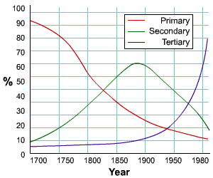
40 35 30 25 20 15 10 5 0
Changing Employment patterns
10. Why did these changes take place
11. Why type of Industry is missing
Slide 11

Slide 12
40 35 30 25 20 15 10 5 0
Industrial Location Factors
12. How do these factors affect the location of Industry
Site, situation, climate, raw materials, component suppliers, universities, water and power supplies, energy, accessibility of transport and communications, capital, labour , market, ready-built accommodation, similar companies nearby, industrial inertia, quality of life (e.g. leisure attractions) and social attractions (e.g. housing, shopping, schools) and government influence (grants, loans and other incentives).
Slide 12

Slide 13
40 35 30 25 20 15 10 5 0
CASE STUDY - Type of FARMING
Outputs
INPUTS
Stores
Impacts
Processes
13. Complete the system diagram
Slide 13

Slide 14
40 35 30 25 20 15 10 5 0
How and why the locations of different economic activities has changed.
14. How has the location of the docks changed in Bristol
15. How has the location of RETAIL changed in Bristol
16. What are the environmental, social and economic reasons for the change in the location of the docks
17. What are the environmental, social and economic reasons for the change in the location of RETAIL
Slide 14

Slide 15
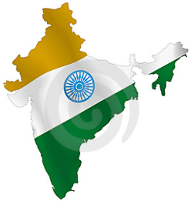
40 35 30 25 20 15 10 5 0
Case study from an LEDC to illustrate the factors that affect the location of different types of economic activity.
18. What is outsourcing?
19. What is offshoring? 20. What is a footloose industry?
21. How did these factors make India a good location for a call centre
Labour | Cost | Geographical Location | Government Policy
22. Give 3 disadvantages of India as a location for call centres
Slide 15

Slide 16
40 35 30 25 20 15 10 5 0
Case study from an MEDC to illustrate the factors that affect the location of different types of economic activity.
Factor | Ebbw Vale 1930 | Port Talbot 2000
Site
Raw Material
Energy
Water
Transport of Raw Materials
Transport of Product
Capital
Markets
Technology
Labour
23. Complete the table
Slide 16

Slide 17
40 35 30 25 20 15 10 5 0
Defining a multinational company and globalisation
24. What is Globalisation?
25. What is the global village ?
26. What is a multinational company?
27. How have technological changes helped globalisation?
28. How have transport changes helped globalisation?
29. What is Foreign Direct Investment?
30. What is a Global Brand?
Slide 17

Slide 18
40 35 30 25 20 15 10 5 0
Defining a multinational company and globalisation
31 Complete the table using named examples
 | Advantages | Disadvantages
Host | 1 2 | 1 2
Recipient | 1 2 | 1 2
Slide 18

Slide 19
40 35 30 25 20 15 10 5 0
CASE STUDY
Outputs
INPUTS
Stores
Impacts
Processes
32. Complete the system diagram
Slide 19

Slide 20
40 35 30 25 20 15 10 5 0
Future Globalisation
33.Give examples of each of the following
Small companies will not be able to compete
Global Shift
Deindustrialisation
Reindustrialisation
Widening wealth gap
Polluters will change.
Growth of the BRICs and a new world order
Africa – a new market
Global civil society
Non-Governmental Organisations (NGO’s)
Slide 20

Slide 21
40 35 30 25 20 15 10 5 0
Climate Change
CAUSE 34. What is the Greenhouse Effect?
EFFECT 35. Explain these consequences
Sea Level Rise
Increase in extreme weather
Changes in global temperature rainfall and wind.
RESPONSE 36. Complete the table
Individuals | Individual Countries | Groups of countries
Slide 21

Slide 22
40 35 30 25 20 15 10 5 0
How different economic activities affect the physical environment.
37. How do the different Industries affect the environment
Primary Industry | Secondary Industry
Tertiary Industry | Quaternary Industry
Slide 22

Slide 23
40 35 30 25 20 15 10 5 0
A case study of a development where conflicts exist between economic development and environmental damage.
CASE STUDY Overfishing in the North Sea
The Issue
The Cause
Social / Economic Impacts | Environmental Impacts
Solutions
38 Complete the boxes
Slide 23

Slide 24
40 35 30 25 20 15 10 5 0
More efficient use of resources Ensuring resources are conserved for future generations by not overusing them in the present | Providing Community based solutions Locally developed initiatives Match local technological capability
Providing Pro Poor solutions Increasing Equality to help the poorest people | Developing Eco friendly and green strategies. Conservation and protection of biodiversity.
Sustainability Quadrant
39 Add the following terms
1. Futurity 2. Social Equality 3. Community Involvement 4. Environmental Conservation 5. Energy efficiency 6. Bottom Up approach 7. carbon capture and storage 8. technology transfer 9. Recycling 10. Appropriate technology 11. renewable energy
Slide 24

Slide 25
Time’s Up
Why not try one of the other lastminuteGCSEgeographyrevision courses

