Slide 1
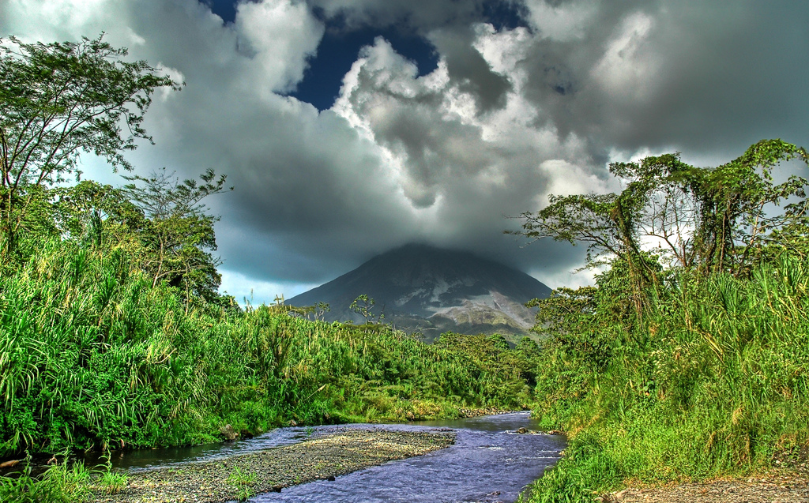
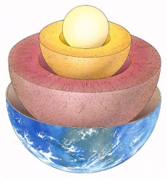
Earthquakes and Volcanoes
Earthquakes and Volcanoes

Slide 2
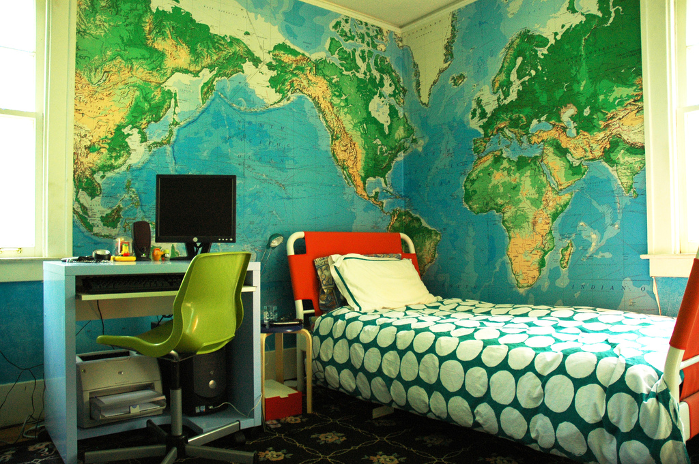
Imagine you are sitting in your room...
You hear a noise...
And the room begins to shake...
Earthquakes and Volcanoes

Slide 3
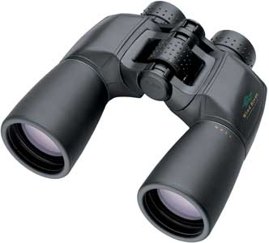
As you walk outside....
Earthquakes and Volcanoes
On your worksheet, write some words that come to mind as you view the devastation that the earthquake has caused.
you see the devastation...

Slide 4
The aftermath...
Use the sketch sheet to draw the scene outside your house / classroom.
Then….
You are asked to write a brief piece of creative writing entitled ‘The earthquake through my eyes’ by a local journalist. You are to write a piece of between 400 – 500 words in total.
Earthquakes and Volcanoes

