Slide 1
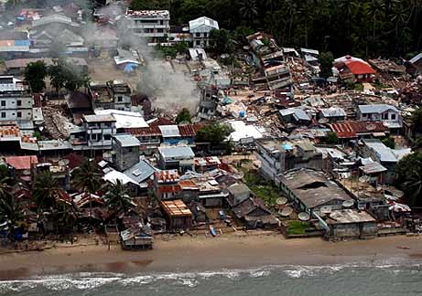
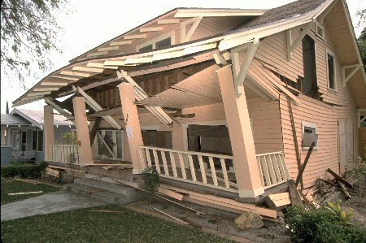
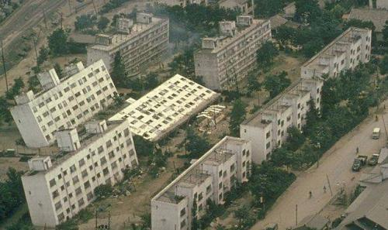
Earthquake Proof Buildings

Slide 2
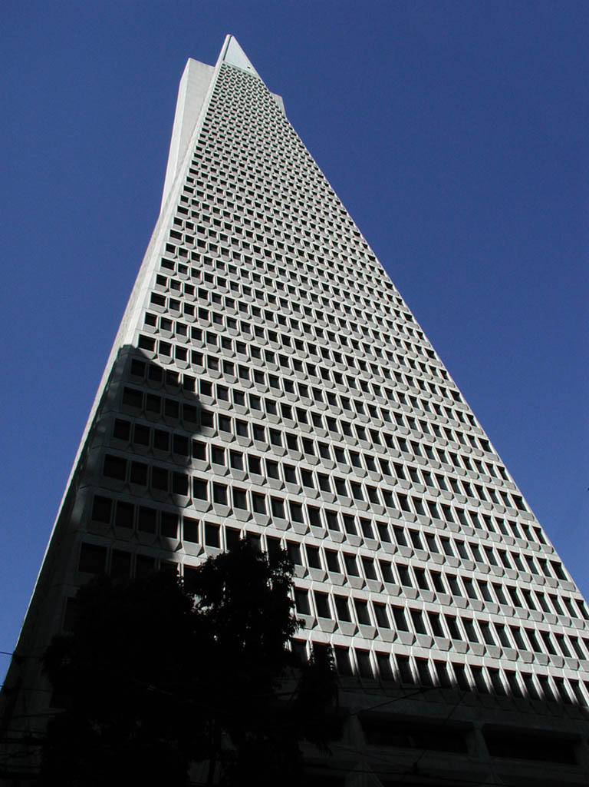
The Transamerica Pyramid, San Fransisco
It has been build pyramid shaped as this is hard to topple over.
http://Footage of the transamerica pyramid/

Slide 3
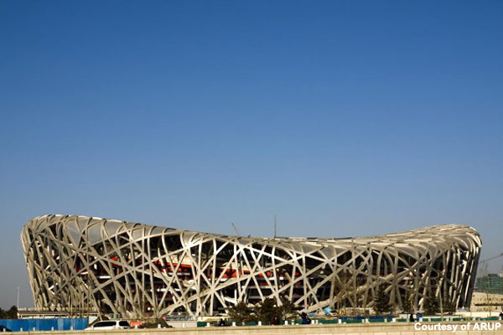
The Beijing National Stadium, China
To earthquake-proof the stadium, the bowl and roof were split into two separate elements and the bowl split into eight zones, each with its own stability system and effectively its own building.

Slide 4
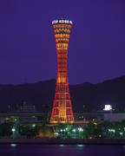
Kobe Port Tower
It is shaped like a traditional Japanese drum and was designed to withstand earthquakes, which it did during the 1995 Kobe Earthquake. The rest of the port area was badly affected.

Slide 5
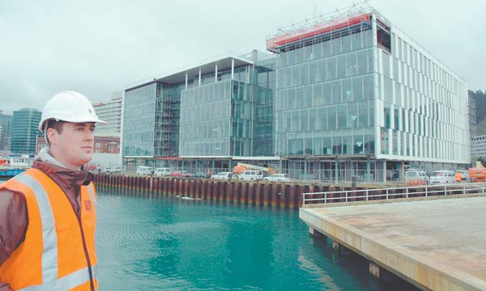
CentrePort Building, Wellington, New Zealand
In the event of an earthquake, the three piers can move independently of one another without destroying the bridges, which link the piers together

Slide 6
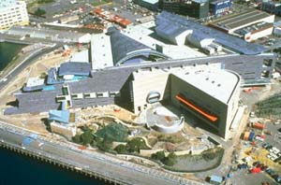
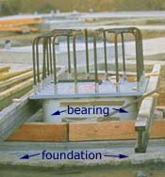
Rubber bearings
Dampers can be added that will allow the building to stay still while they move from side to side.
Rubber bearings animation

Slide 7
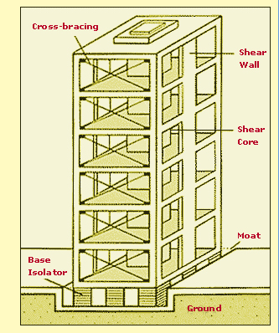
A theoretical design!
It is made stronger by the cross bracing of the walls, the strong core of the building and walls made out of reinforced concrete. There are also shock absorbers in the base of the building. The moat is to allow the building to sway.

Slide 8
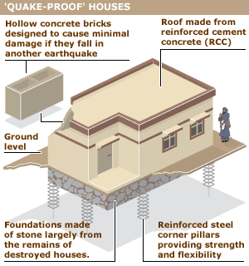
Another design!

Slide 9
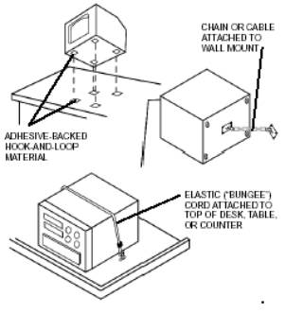
Other things that can be done
Windows made from shatter proof glass
Bookselves screwed to wall
Heavy objects attached tables and walls
Earthquake kit
Pictures screwed to walls rather than hung on nails

Slide 10
Your task
Draw your design for an earthquake proof building
Add detailed labels that show why it is earthquake proof
Describe what materials you would use to build it e.g. reinforced concrete, shatterproof glass
Explain what things you would do inside the building to make it safer in earthquakes

