Slide 1
Lifespan
80
This graph shows income and lifespan in the world today. Each bubble is a country.
70
60
50
Income
$500
$5 000
$50 000
Sources: After 1950: UN World Pop. Prosp. 2012. Before 1950: hundreds of sources combined by Gapminder.
www.gapminder.org/teach
Free teaching material for a fact-based worldview
Version: 1

Slide 2
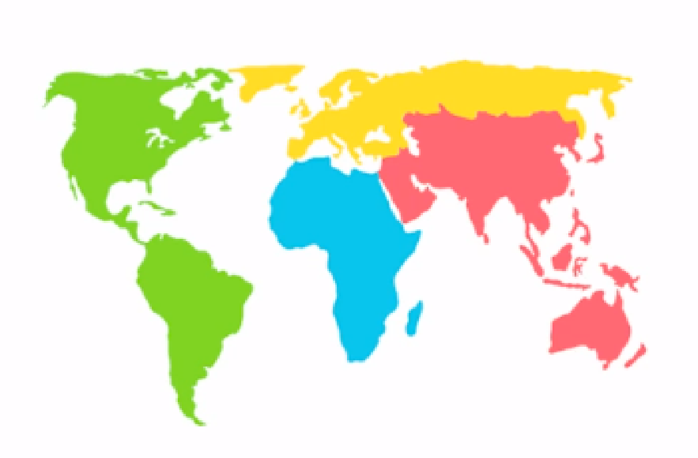
Lifespan
80
70
Color shows region.
60
50
Income
$500
$5 000
$50 000
Sources: After 1950: UN World Pop. Prosp. 2012. Before 1950: hundreds of sources combined by Gapminder.
www.gapminder.org/teach
Free teaching material for a fact-based worldview
Version: 1

Slide 3
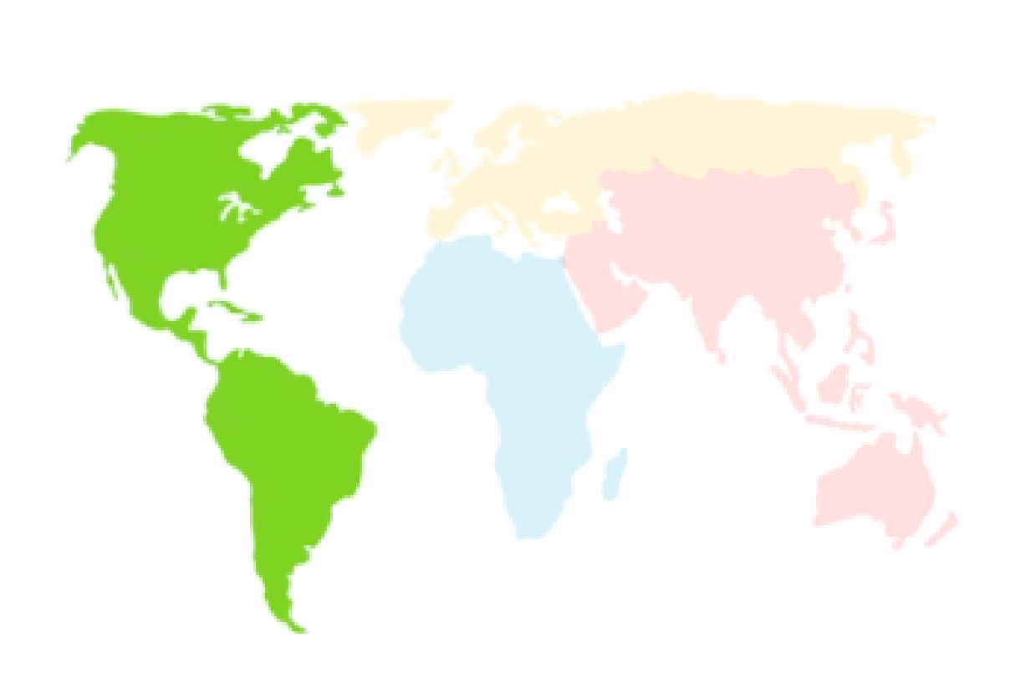
Lifespan
80
Americas
70
60
50
Income
$500
$5 000
$50 000
Sources: After 1950: UN World Pop. Prosp. 2012. Before 1950: hundreds of sources combined by Gapminder.
www.gapminder.org/teach
Free teaching material for a fact-based worldview
Version: 1

Slide 4
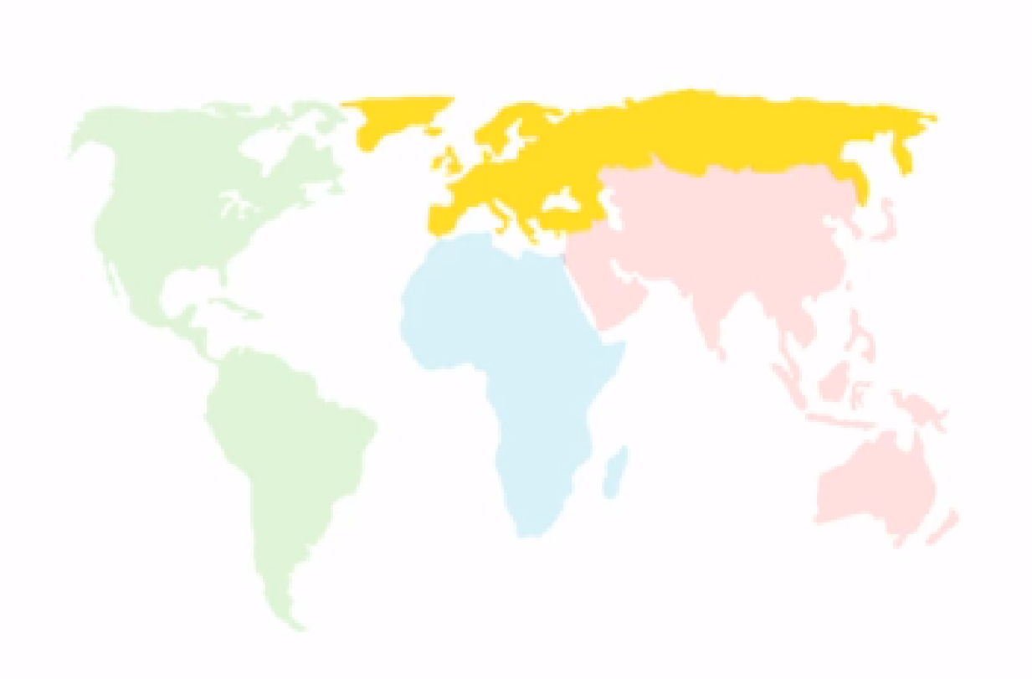
Lifespan
80
Europe
70
60
50
Income
$500
$5 000
$50 000
Sources: After 1950: UN World Pop. Prosp. 2012. Before 1950: hundreds of sources combined by Gapminder.
www.gapminder.org/teach
Free teaching material for a fact-based worldview
Version: 1

Slide 5
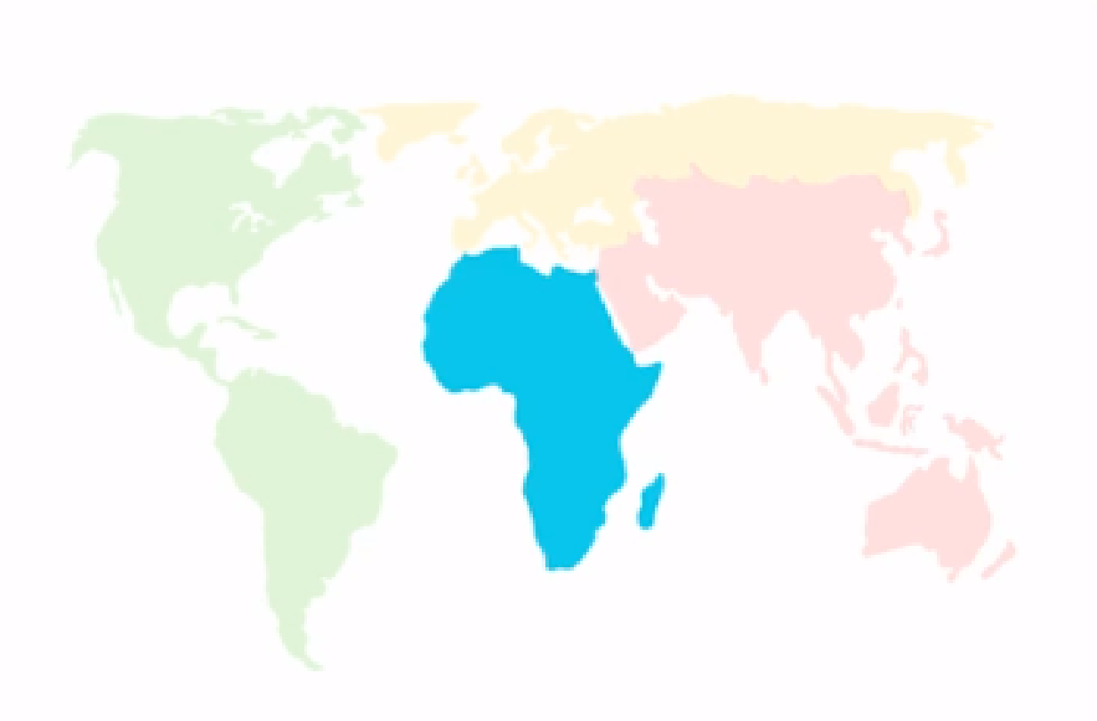
Lifespan
80
70
Africa
60
50
Income
$500
$5 000
$50 000
Sources: After 1950: UN World Pop. Prosp. 2012. Before 1950: hundreds of sources combined by Gapminder.
www.gapminder.org/teach
Free teaching material for a fact-based worldview
Version: 1

Slide 6
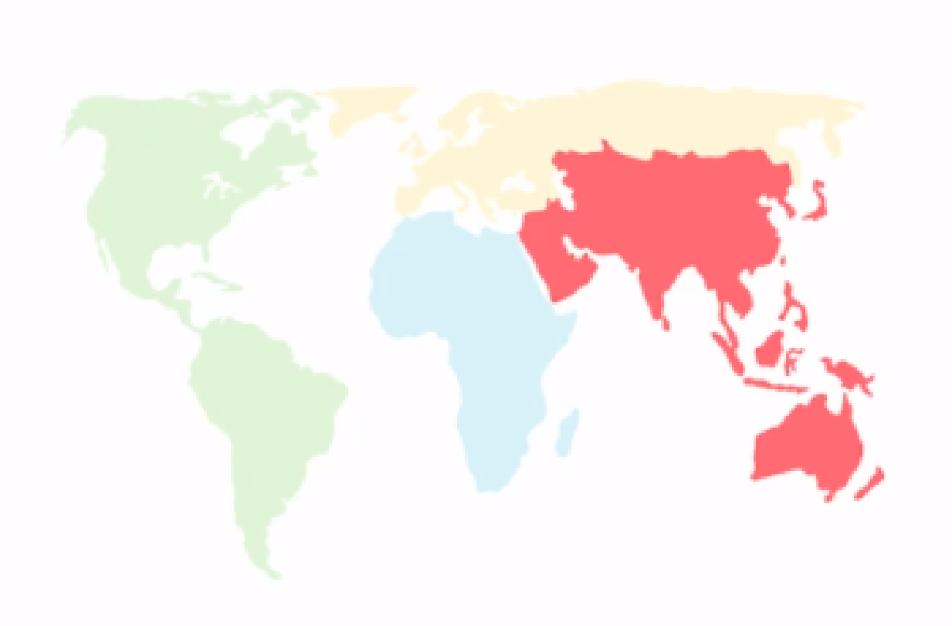
Lifespan
80
Asia
70
60
50
Income
$500
$5 000
$50 000
Sources: After 1950: UN World Pop. Prosp. 2012. Before 1950: hundreds of sources combined by Gapminder.
www.gapminder.org/teach
Free teaching material for a fact-based worldview
Version: 1

Slide 7
Lifespan
80
The size of the bubble represents the population.
70
60
50
Income
$500
$5 000
$50 000
Sources: After 1950: UN World Pop. Prosp. 2012. Before 1950: hundreds of sources combined by Gapminder.
www.gapminder.org/teach
Free teaching material for a fact-based worldview
Version: 1

Slide 8
Lifespan
This is China.
80
70
60
50
Income
$500
$5 000
$50 000
Sources: After 1950: UN World Pop. Prosp. 2012. Before 1950: hundreds of sources combined by Gapminder.
www.gapminder.org/teach
Free teaching material for a fact-based worldview
Version: 1

Slide 9
Lifespan
80
And this is India.
70
60
50
Income
$500
$5 000
$50 000
Sources: After 1950: UN World Pop. Prosp. 2012. Before 1950: hundreds of sources combined by Gapminder.
www.gapminder.org/teach
Free teaching material for a fact-based worldview
Version: 1

Slide 10
Lifespan
80
70
The Income axis represents GDP per capita from $500 all the way to $50 000 per person and year.
60
50
Income
$500
$5 000
$50 000
Sources: After 1950: UN World Pop. Prosp. 2012. Before 1950: hundreds of sources combined by Gapminder.
www.gapminder.org/teach
Free teaching material for a fact-based worldview
Version: 1

Slide 11
Lifespan
80
The Lifespan axis shows life expectancy in years.
70
60
50
Income
$500
$5 000
$50 000
Sources: After 1950: UN World Pop. Prosp. 2012. Before 1950: hundreds of sources combined by Gapminder.
www.gapminder.org/teach
Free teaching material for a fact-based worldview
Version: 1

Slide 12
Lifespan
80
70
These countries have the lowest income and the shortest life expectancy.
60
50
Income
$500
$5 000
$50 000
Sources: After 1950: UN World Pop. Prosp. 2012. Before 1950: hundreds of sources combined by Gapminder.
www.gapminder.org/teach
Free teaching material for a fact-based worldview
Version: 1

Slide 13
Lifespan
80
There are countries of all levels of income and lifespan.
70
60
50
Income
$500
$5 000
$50 000
Sources: After 1950: UN World Pop. Prosp. 2012. Before 1950: hundreds of sources combined by Gapminder.
www.gapminder.org/teach
Free teaching material for a fact-based worldview
Version: 1

Slide 14
Lifespan
80
70
These countries have the highest income and the longest life expectancy.
60
50
Income
$500
$5 000
$50 000
Sources: After 1950: UN World Pop. Prosp. 2012. Before 1950: hundreds of sources combined by Gapminder.
www.gapminder.org/teach
Free teaching material for a fact-based worldview
Version: 1

Slide 15
Lifespan
80
74
70
There are no countries here. On this high income, there are no countries with life expectancy below 74.
60
50
Income
$500
$5 000
$50 000
Sources: After 1950: UN World Pop. Prosp. 2012. Before 1950: hundreds of sources combined by Gapminder.
www.gapminder.org/teach
Free teaching material for a fact-based worldview
Version: 1

Slide 16
Lifespan
80
There’s no country here. On this low income, there’s no country with life expectancy above 64.
70
64
60
50
Income
$500
$5 000
$50 000
Sources: After 1950: UN World Pop. Prosp. 2012. Before 1950: hundreds of sources combined by Gapminder.
www.gapminder.org/teach
Free teaching material for a fact-based worldview
Version: 1

Slide 17
Most people live in middle income countries.
Lifespan
80
70
60
50
Income
$500
$5 000
$50 000
Sources: After 1950: UN World Pop. Prosp. 2012. Before 1950: hundreds of sources combined by Gapminder.
www.gapminder.org/teach
Free teaching material for a fact-based worldview
Version: 1

Slide 18
On the same income level there are huge differences in lifespan.
From 50 all the way up to 75 years, depending on how the money is distributed and how it’s used.
Lifespan
80
70
60
50
Income
$500
$5 000
$50 000
Sources: After 1950: UN World Pop. Prosp. 2012. Before 1950: hundreds of sources combined by Gapminder.
www.gapminder.org/teach
Free teaching material for a fact-based worldview
Version: 1

Slide 19
TEACHING A FACT-BASED WORLDVIEW
Learn more about our free teaching materials here: www.gapminder.org/for-teachers
If you have questions or feedback, please tell us here
OPEN LICENSE
This file is freely available under Creative Common Attribution License 4.0
Which means: Please use it and spread it in any way you want!
You are allowed to
Remix - You are allowed to change the material and include fragments of it in other works.
Spread - You are allowed to make copies, distribute, publish and transmit the material.
Sell - You are allowed to include the material in commercial products or services that you charge for.
The only requirements are:
Trademark - Don't include the word "GAPMINDER" and the logotypes in your products or service, and if you change the meaning of the slides, you must remove the Gapminder trademarks.
Attribution - You must make clear to others the license terms of this work and include the citation below.
Required attribution: ”Free teaching material from www.gapminder.org”
The Gapminder Foundation is a Swedish not-for-profit organization, independent from all political, commercial and religious affiliations. Gapminder’s mission is to fight devastating ignorance with a fact-based worldview that everyone can understand. Gapminder’s chairman Hans Rosling is a professor of International Health at the Karolinska Institute, Stockholm, Sweden. For more information visit: www.gapminder.org
www.gapminder.org/teach
Free teaching material for a fact-based worldview
Version: 1

Slide 20
Q1
SLIDESHOWS
— How Does Income Relate to Life Expectancy?
Short answer — Rich people live longer
www.gapminder.org/answers
www.gapminder.org/teach
Free teaching material for a fact-based worldview
Version: 1
Notes:
This is a title slide, if you want one.

